Slide 1


Activity: Data Collection, Cleaning and Sketching
Instructor: Shri Harini Ramesh
April 28 – May 2, 2025

Slide 2
Goal
Create a survey using Google Forms
Practice cleaning and organizing the responses
Sketch visualizations

Slide 3
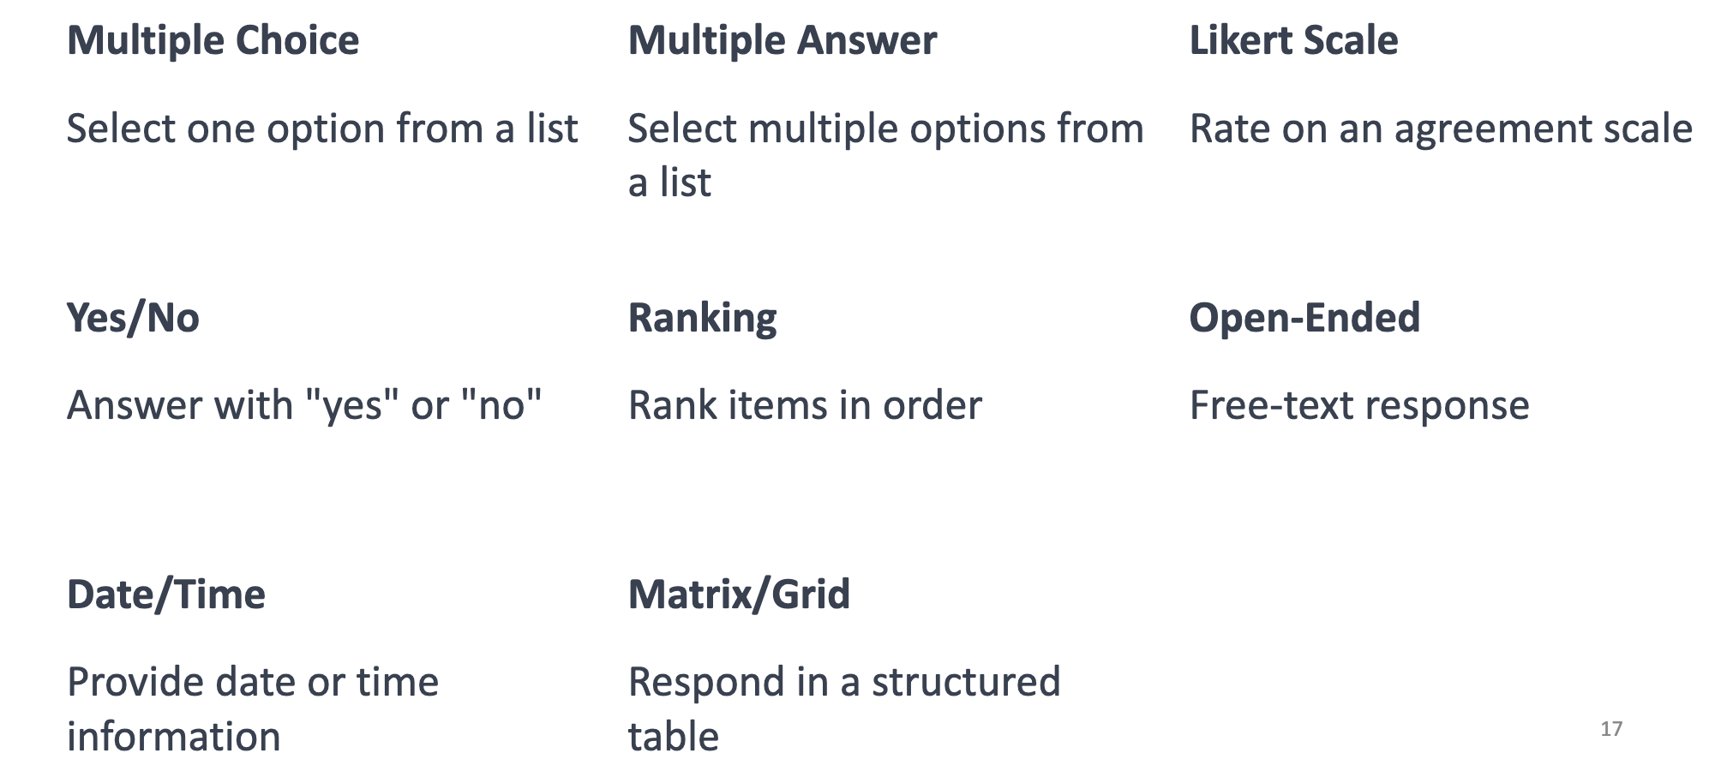
Collect Your Survey Data
Make sure your form includes a variety of question types

Slide 4
Collect Your Survey Data
You can collect data through Google Forms, Notebook or Short Interviews.
As a team, create one questionnaire that will be used to collect data from at least 20 classmates
Before sending out your survey or interviewing others…
Show your questionnaire to me for feedback

Slide 5
Good Questions Are...
Clear (easy to understand)
❌ Bad Example: ➔ "Did you drink a healthy amount of water?" (What is “healthy”? Different for everyone! Not clear!)
✅ Good Example: ➔ "How many glasses of water did you drink yesterday?”

Slide 6
Good Questions Are...
Specific (no confusion)
❌ Bad Example: ➔ "Are you a night owl?" (Vague — what does "night owl" really mean? Hard to answer exactly)
✅ Good Example: ➔ "At what time did you go to bed last night?"

Slide 7
Good Questions Are...
Easy to Answer (quick for people)
❌ Bad Example: ➔ "Explain your daily fitness routine in detail." (Too long, hard to answer quickly!)
✅ Good Example: ➔ "How many steps did you walk today?" (Just a number — quick and simple!)

Slide 8
Clean and Organize Data (Excel)
What to Look For:
Spelling errors
Missing data
Inconsistent units (e.g., mins vs. hours)
Weird formatting (extra spaces, wrong cases)
Organizing Tips:
Use filters, sort, and conditional formatting
Standardize columns (use same format throughout)

Slide 9
Present Your Insights Through Sketches
Turn your collected and cleaned data into a visual story!
Use sketches or paper (provided in class) to create a rough data dashboard or chart that reveals something interesting

Slide 10
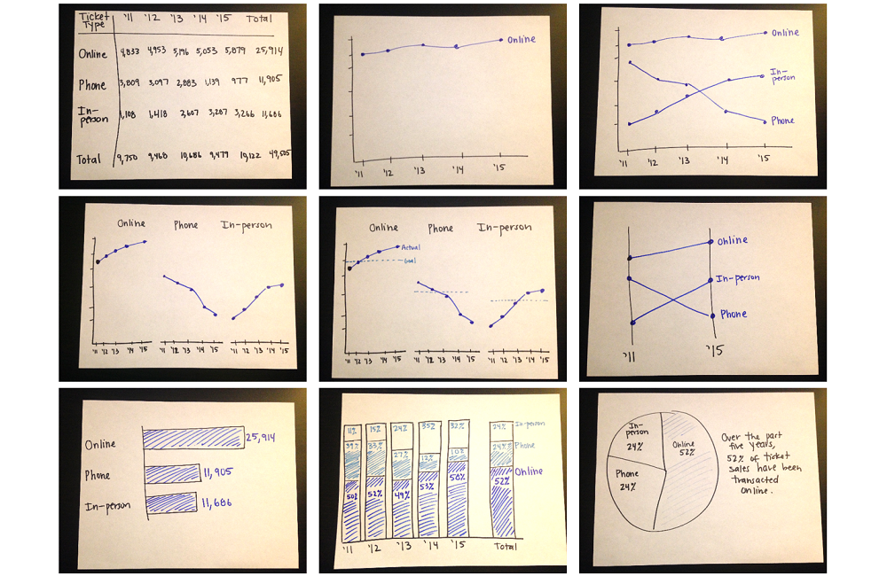
Examples

Slide 11
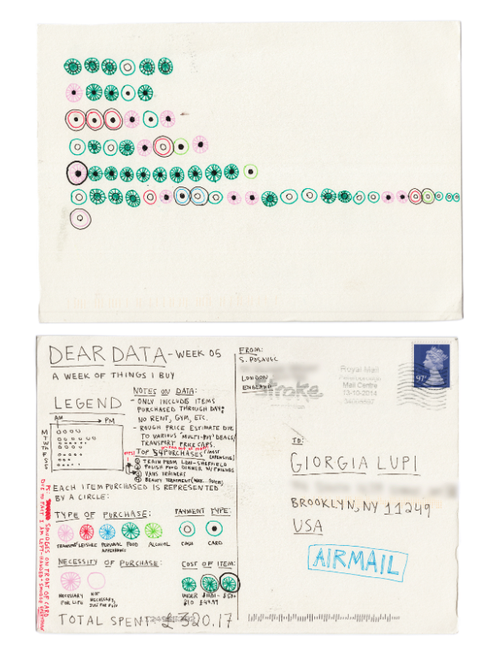
Examples

Slide 12
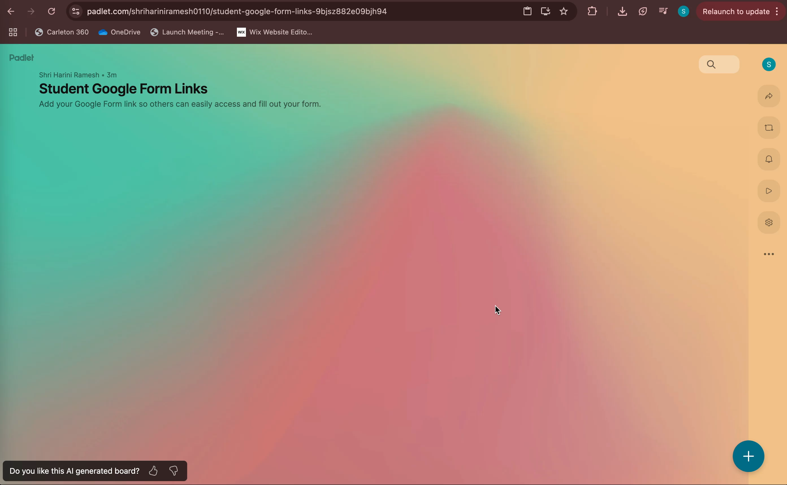

Slide 13
Tasks (1.5hrs)
5. Organize Your Files ➔ Go to website (Day 2) ➔ Open Google Drive link ➔ Create a folder under "Day 2" with your group name ➔ Upload:
Raw Data
Cleaned Data
Sketch Photos
Final Presentation (slides)
6. Prepare Presentation ➔ Show your whole story:
Your survey idea
Collection process
How you cleaned data
Insights found
Why you chose your chart design
7. Present to Class! (3 minutes) ➔ Make it fun, creative, and clear!
Upload Google Form Link ➔ Go to website (Day 2) ➔ Open Padlet link
➔ Post your form link on Padlet
2. Collect Responses ➔ Get answers from everyone outside your group
3. Clean Your Data ➔ Fix any spelling mistakes, weird characters, empty spaces, inconsistent units
4. Create Sketches ➔ Draw quick graphs/charts showing insights from your data

