Slide 1


Introduction to Artificial Intelligence
Instructor: Shri Harini Ramesh
April 28 – May 2, 2025

Slide 2
What is Artificial Intelligence (AI)?
AI is when machines perform tasks that usually require human intelligence.
Examples:
Recognizing images (Face ID)
Making decisions (Self-driving cars)
Understanding language (ChatGPT)

Slide 3
What’s the most interesting or scary use of AI you’ve heard of?

Slide 4
Let’s imagine you want to teach a computer to tell the difference between a cat and a dog in a photo

Slide 5
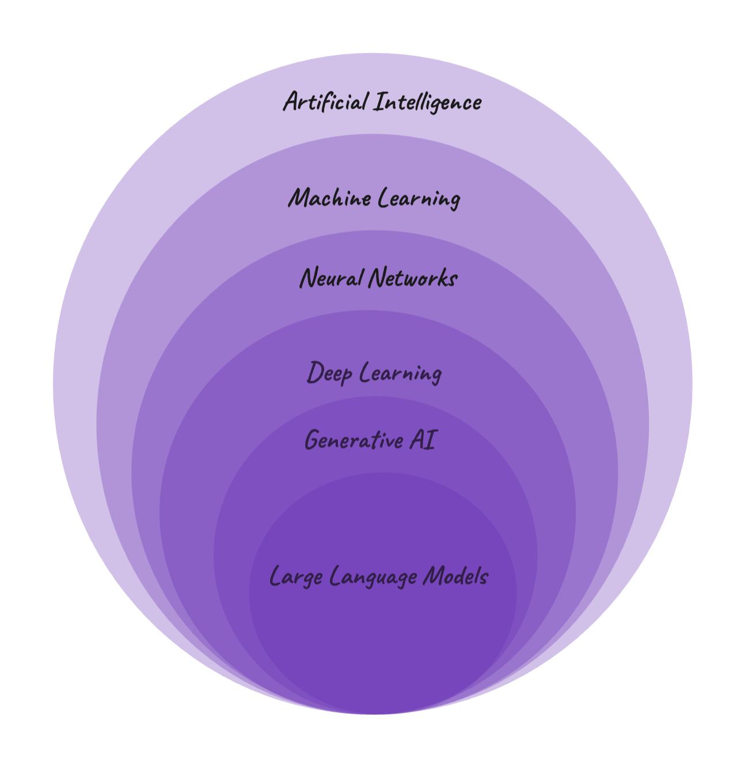

Slide 6
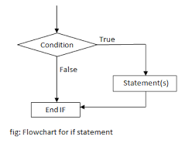
Rule based AI
Follows strict instructions we give it, like a recipe. It doesn’t learn—it just does what it’s told.
If the animal has pointy ears and whiskers, it’s a cat. If it has floppy ears and a wagging tail, it’s a dog.

Slide 7
Machine Learning
Machine Learning is a type of AI where the computer learns from example
We show the computer lots of pictures labeled “dog” or “cat” (e.g., 100 dogs, 100 cats

Slide 8
Neural Networks
Neural Networks work like a mini brain. They’re made of layers of “neurons” (like brain cells) that pass information to solve problems.
Neural Network takes a picture and breaks it into pieces (like pixels, edges, or shapes).

Slide 9
Deep Learning
Deep Learning is a type of Machine Learning that uses Neural Networks with lots of layers
One layer might notice tiny details like whisker patterns, another spots eye shapes, and another combines them to understand the whole animal
It’s great at spotting dogs and cats even in tricky pictures, like a fluffy cat that looks a bit like a dog

Slide 10
Gen AI
Creates new things, like pictures, stories, or even sounds, based on what it’s learned
Instead of just saying “dog” or “cat,” Generative AI could create a brand-new picture of a dog or cat that doesn’t exist!

Slide 11
LLM
Specialize in words and text
if we ask, “Describe a dog,” it might say, “A dog has four legs, a wagging tail, and loves to bark.”

