Slide 1


Data Visualization
Instructor: Shri Harini Ramesh
April 28 – May 2, 2025

Slide 2
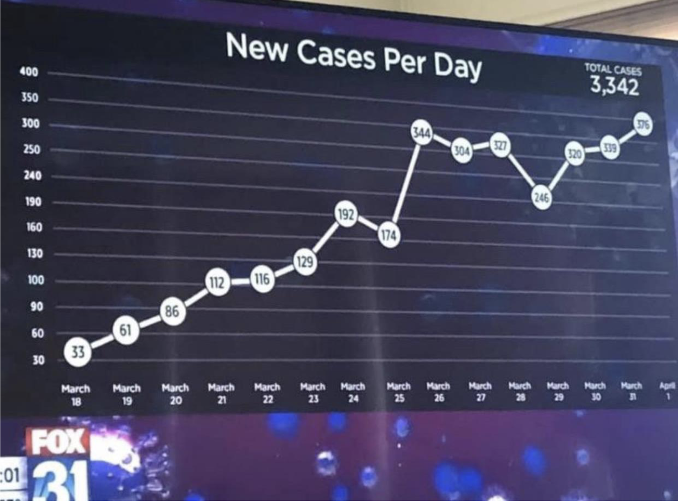
Good, Bad, & Ugly Covid Vis

Slide 3
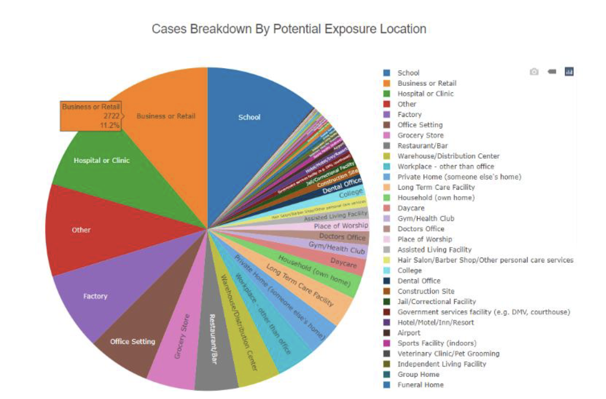
Good, Bad, & Ugly Covid Vis

Slide 4
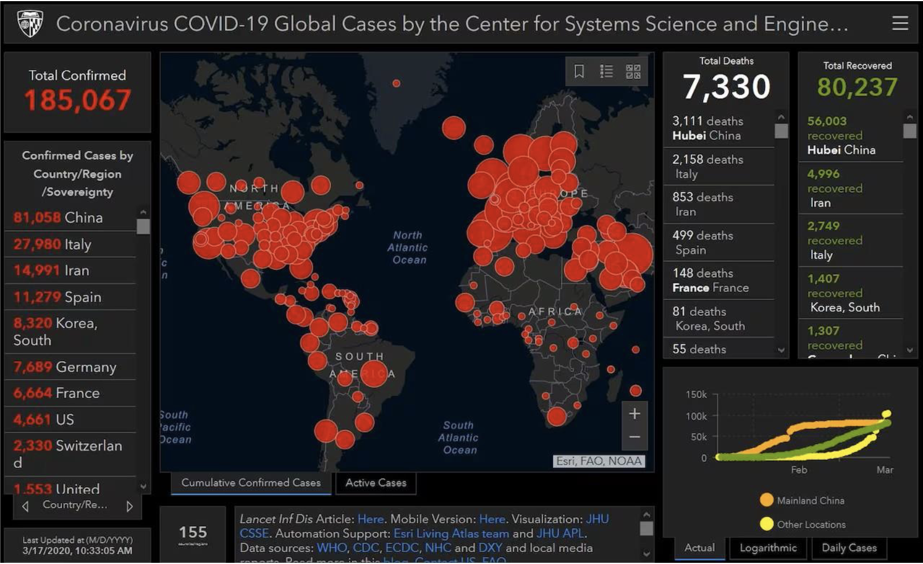
Good, Bad, & Ugly Covid Vis

Slide 5
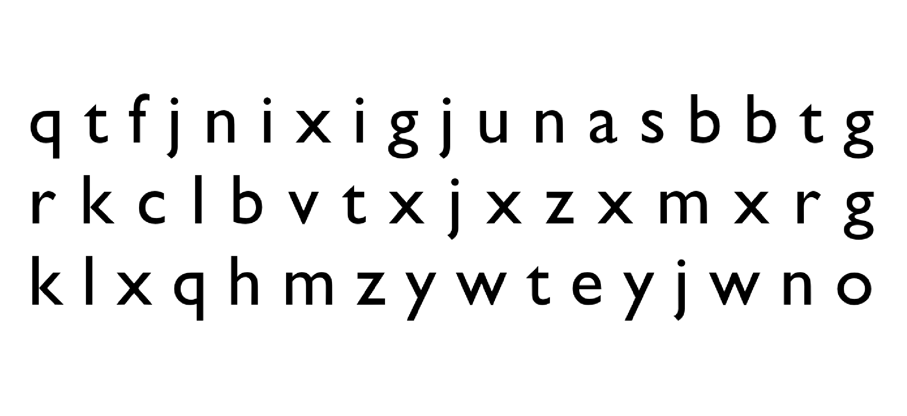
Count Number Of “t”

Slide 6
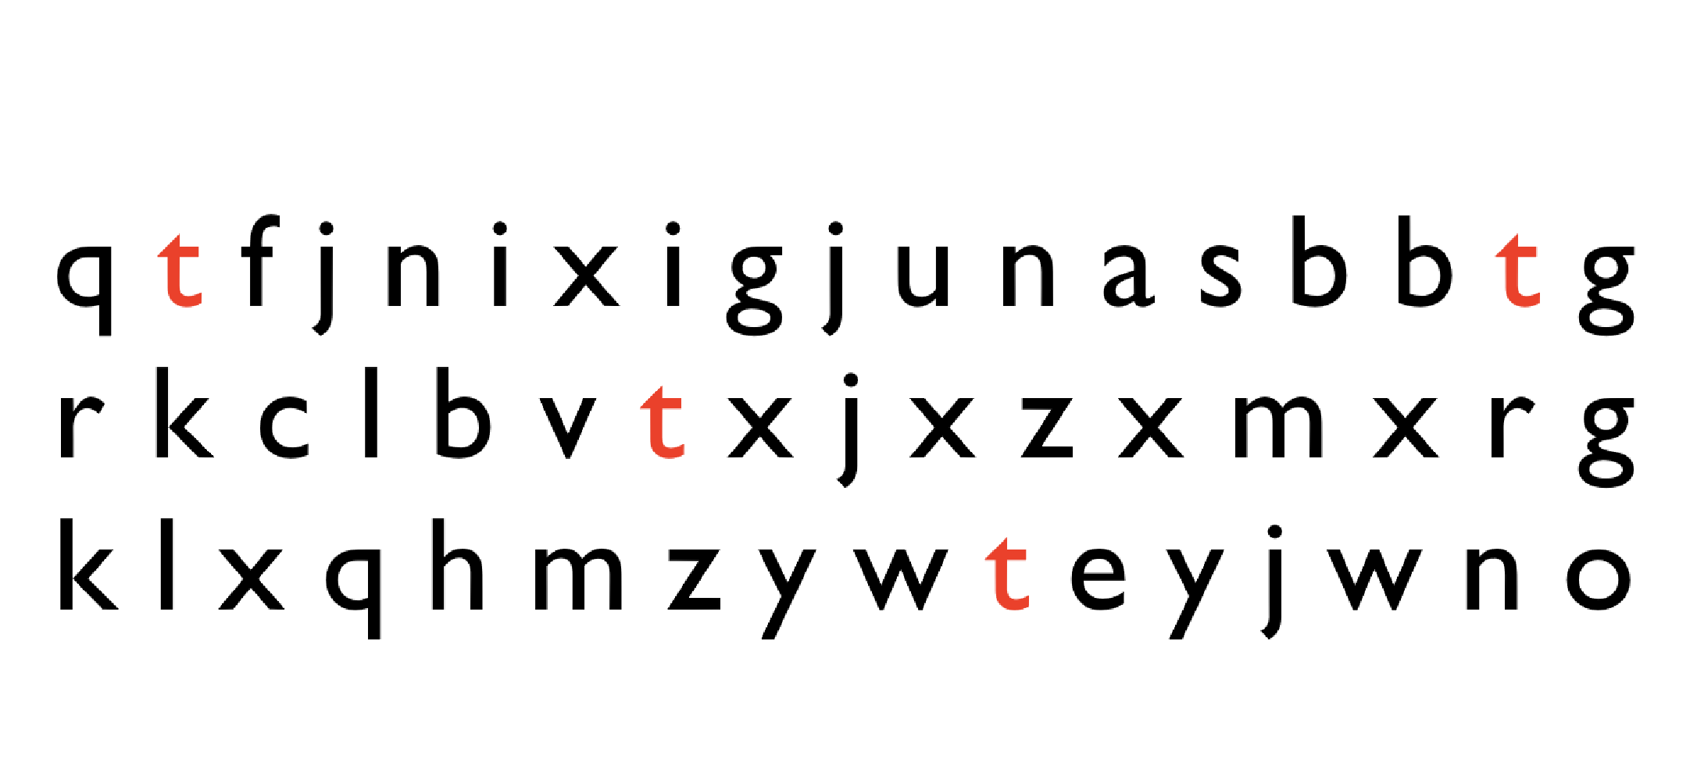
Count Number Of “t”

Slide 7
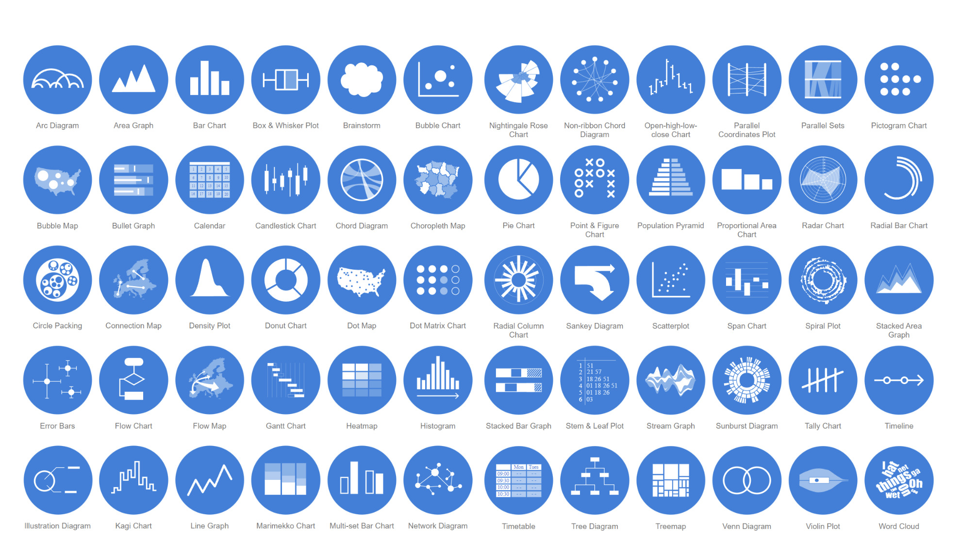
https://datavizcatalogue.com/

Slide 8
Visualize this dataset
75 and 37

Slide 9
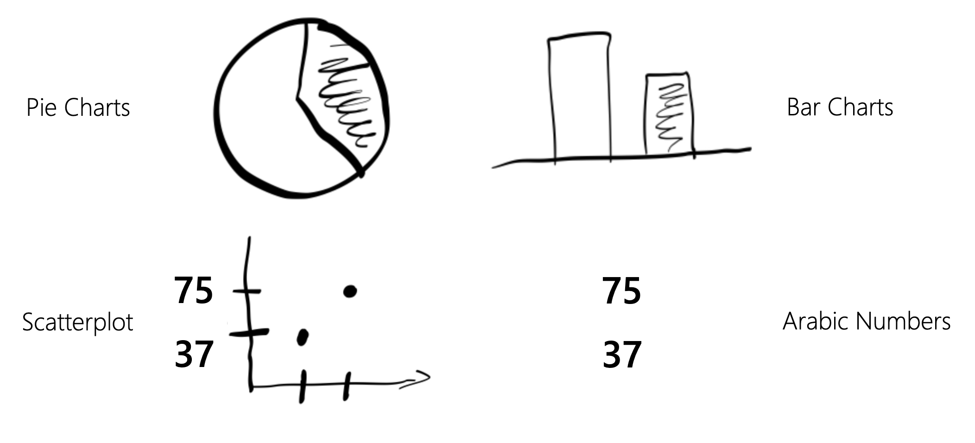
Most Likely Results

Slide 10
How many different ways is it possible to
visualize two numbers?
75 and 37

Slide 11
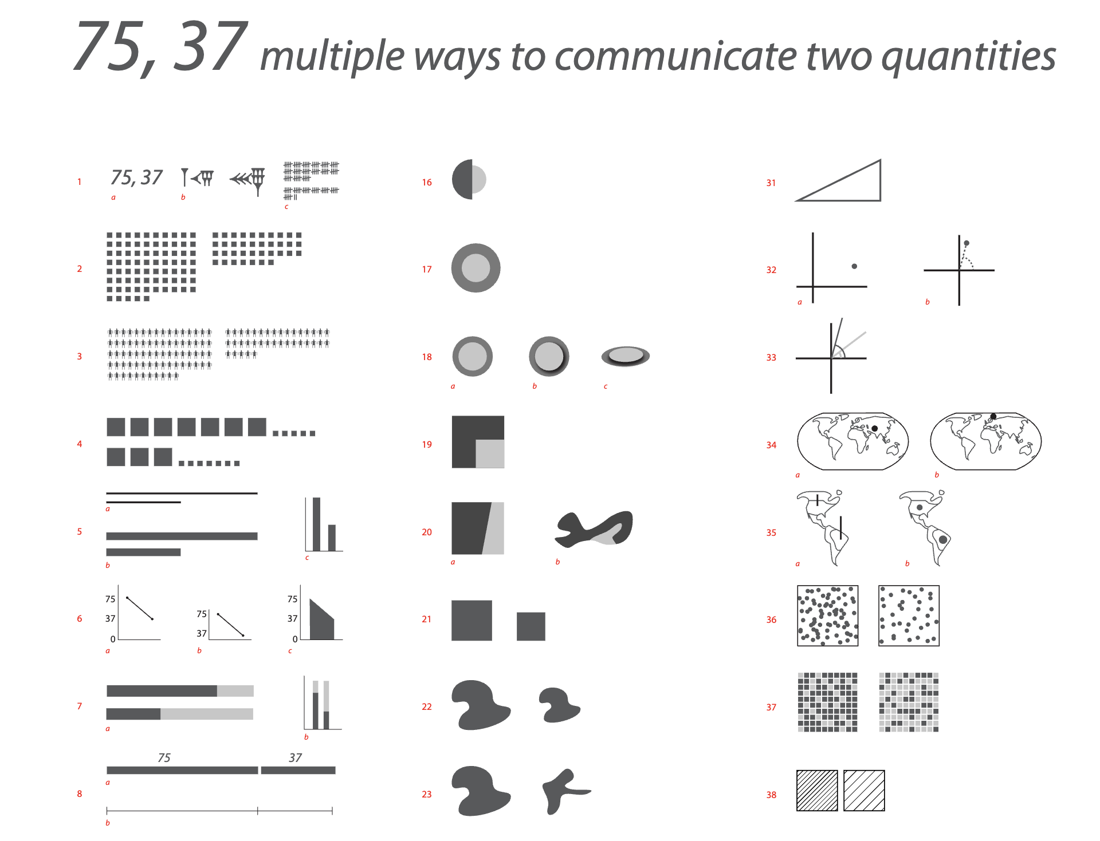
Nutrition

Slide 12
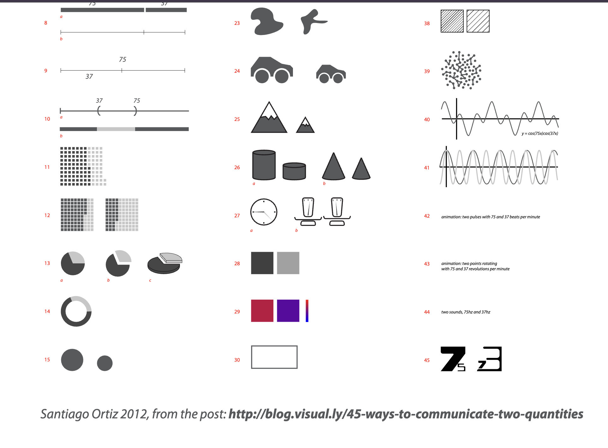
Nutrition

Slide 13
Information visualization is a language!

Slide 14


Slide 15
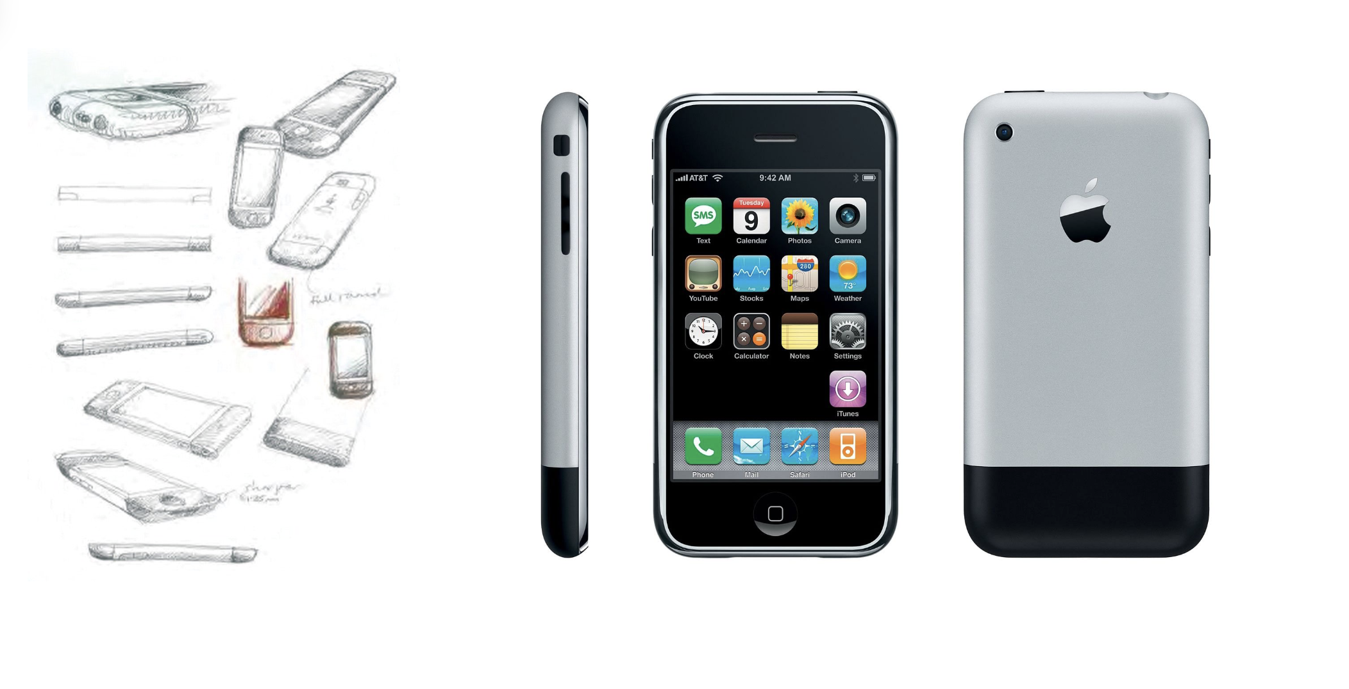

Slide 16


Slide 17
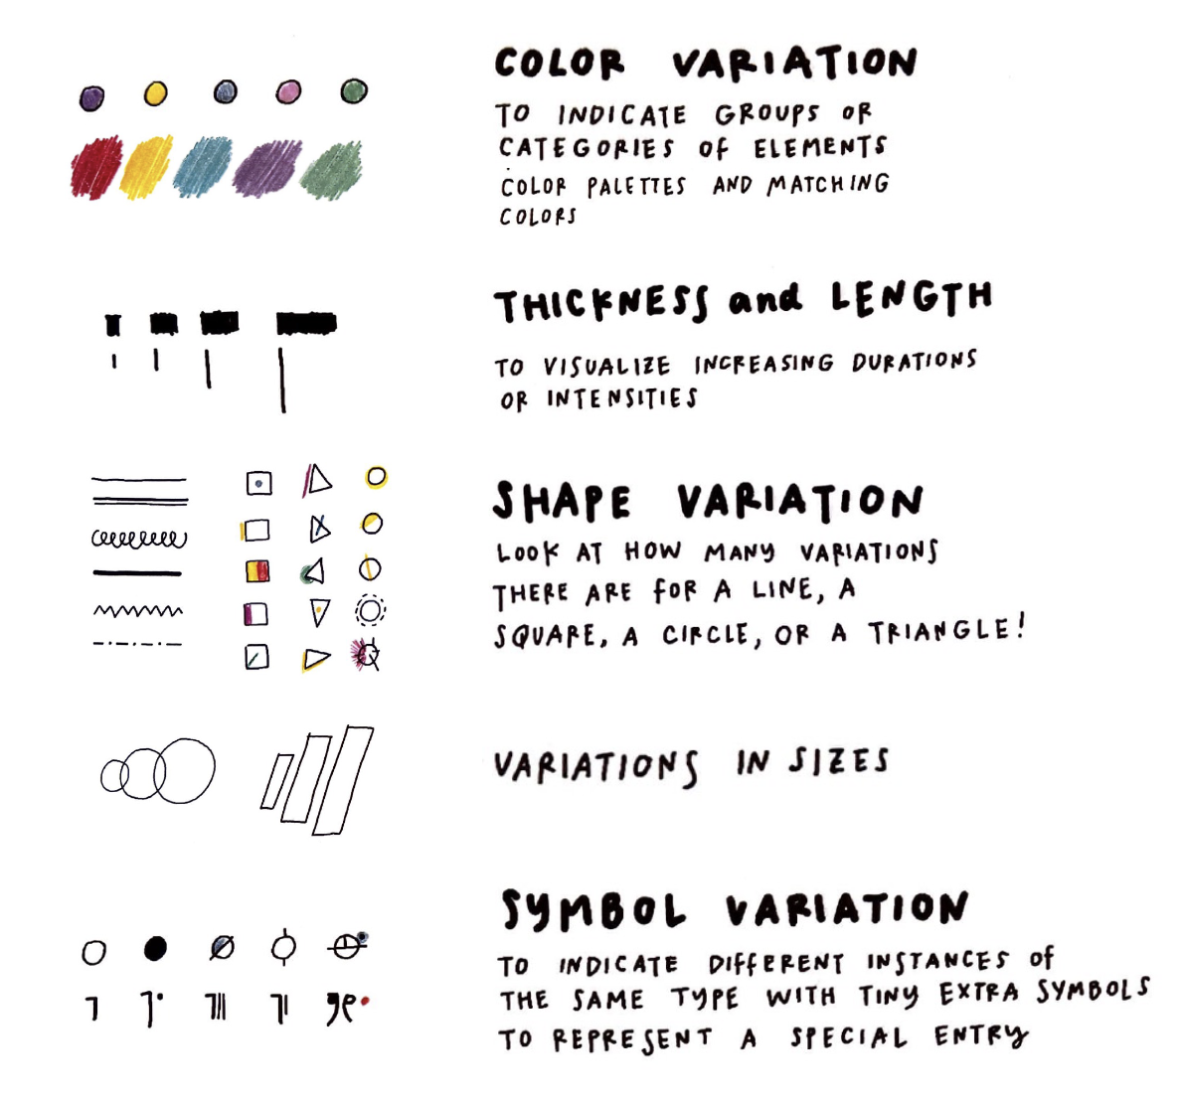

Slide 18
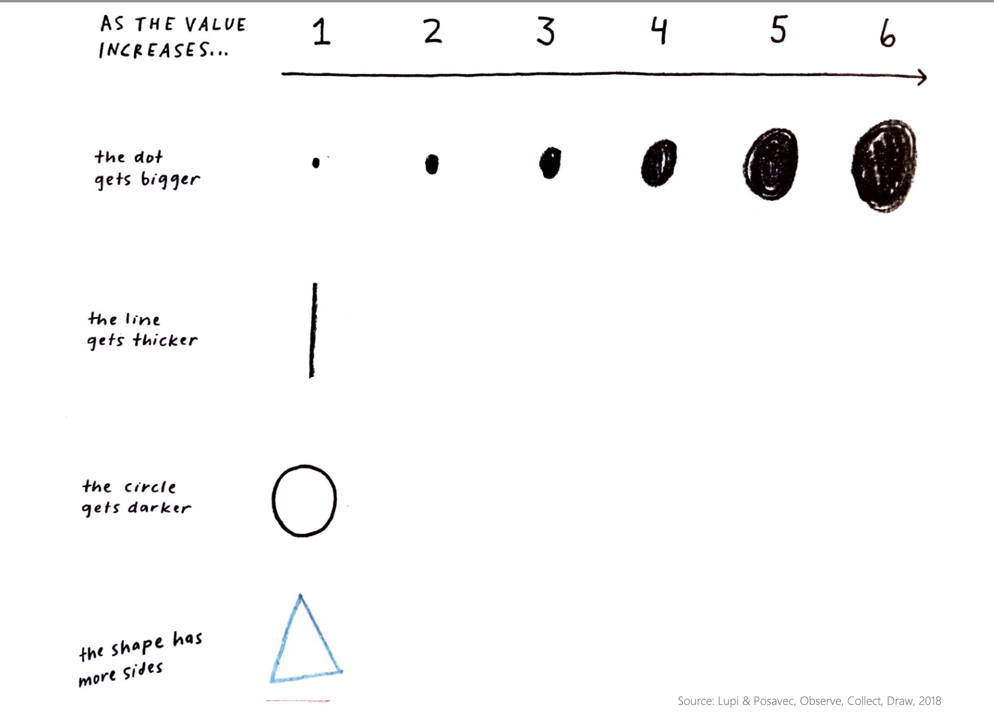

Slide 19
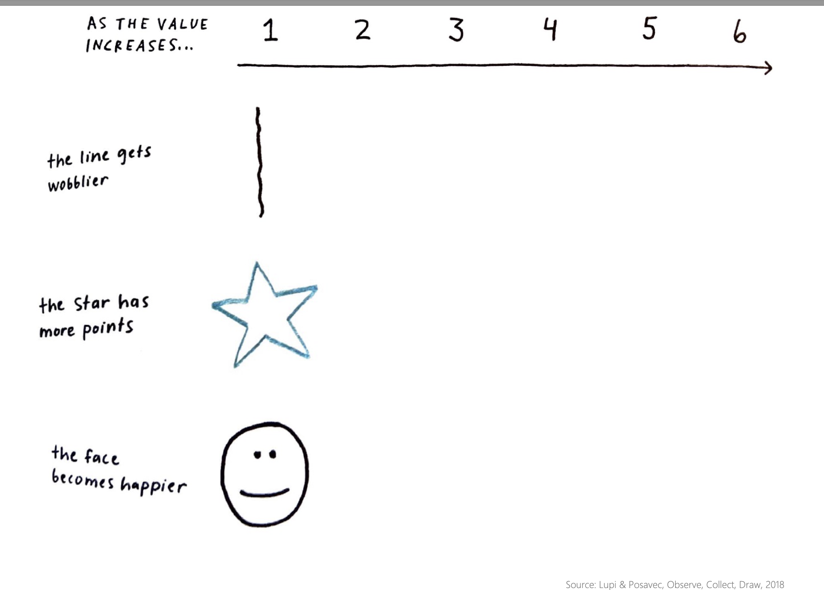

Slide 20
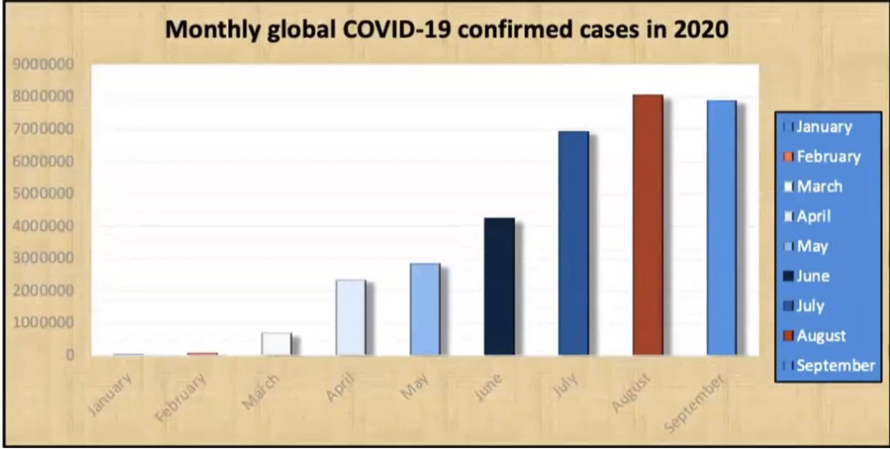
Critique This Viz

Slide 21
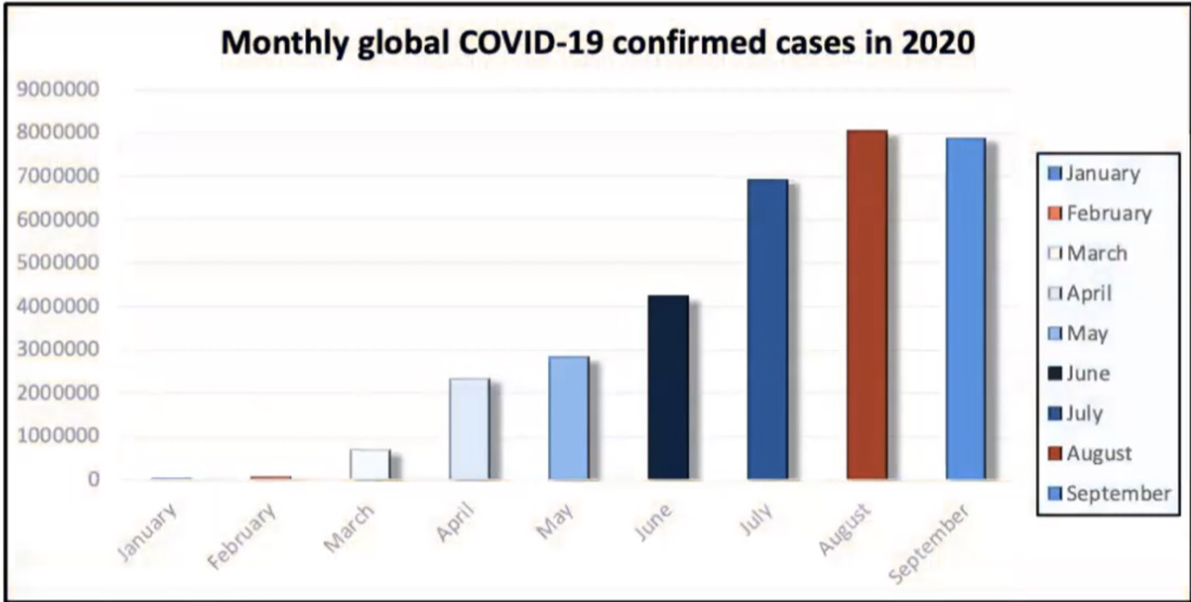
Critique This Viz

Slide 22
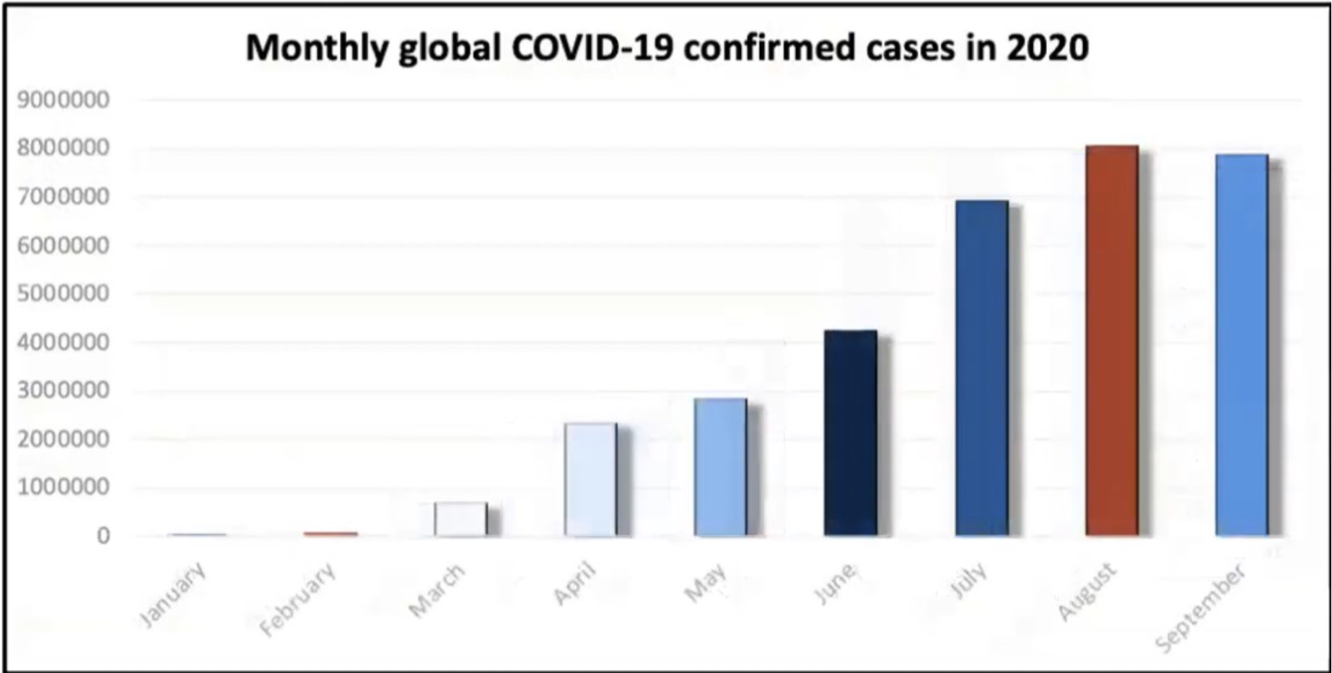
Critique This Viz

Slide 23
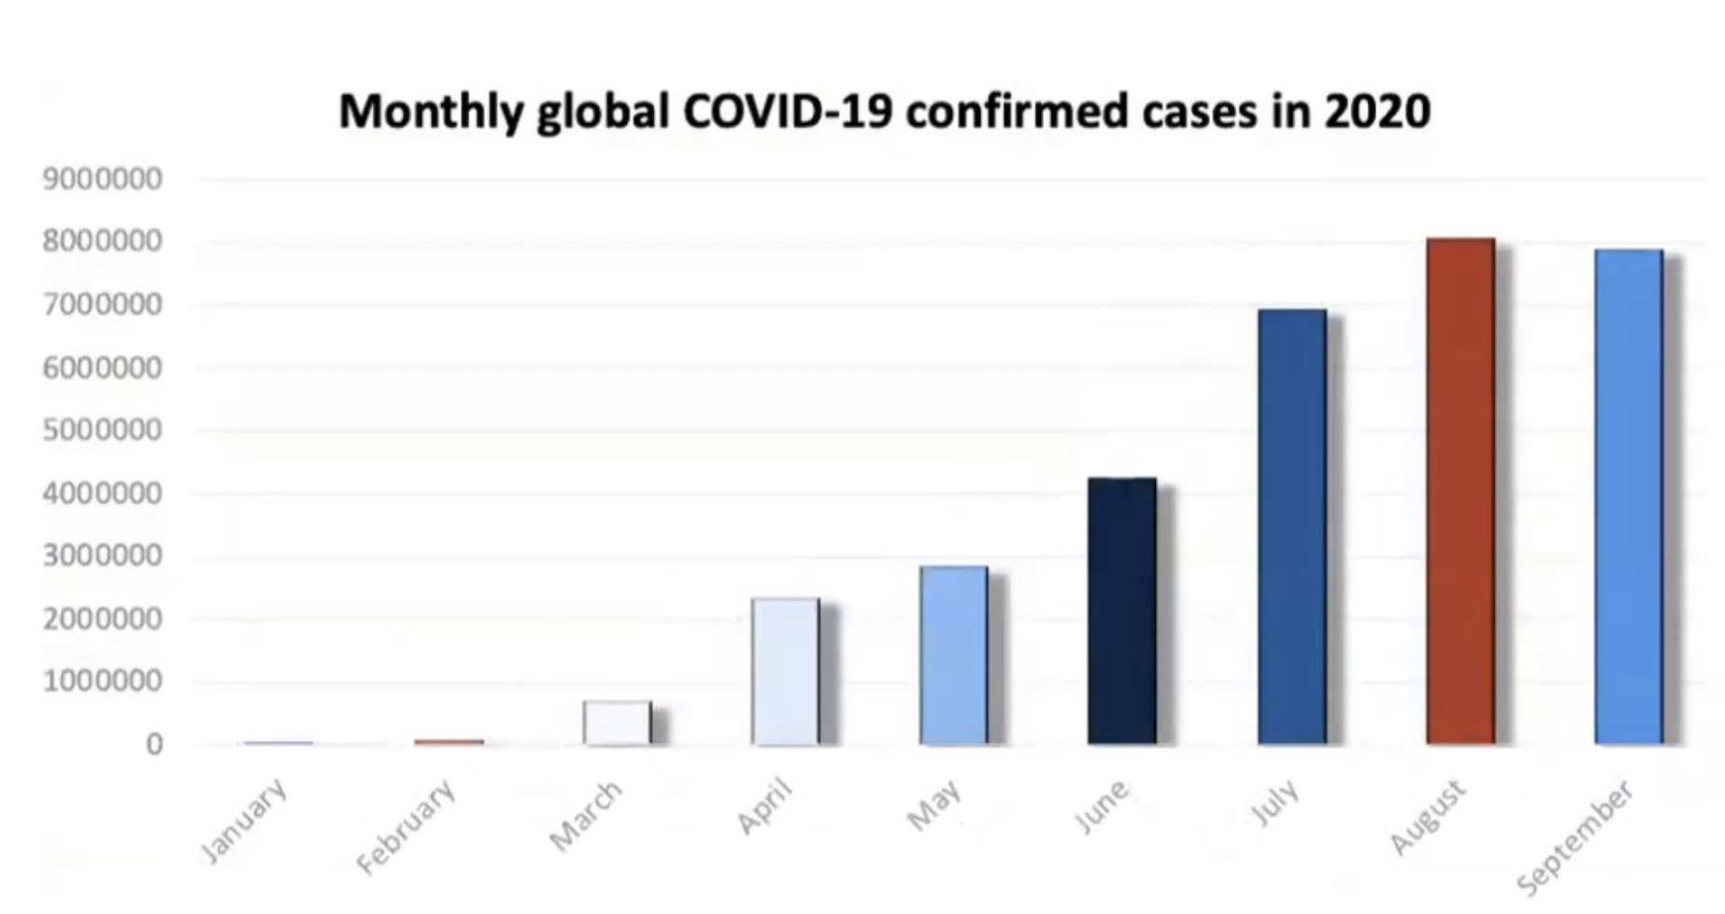
Critique This Viz

Slide 24
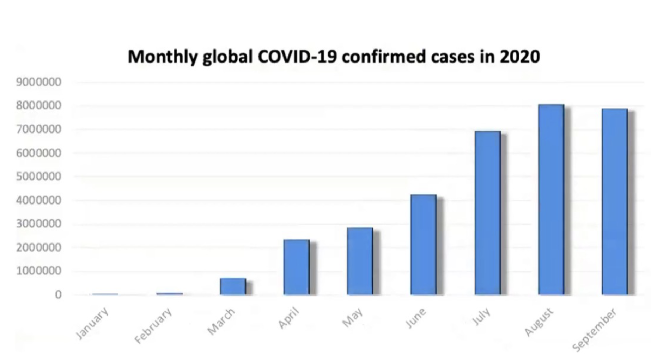
Critique This Viz

Slide 25
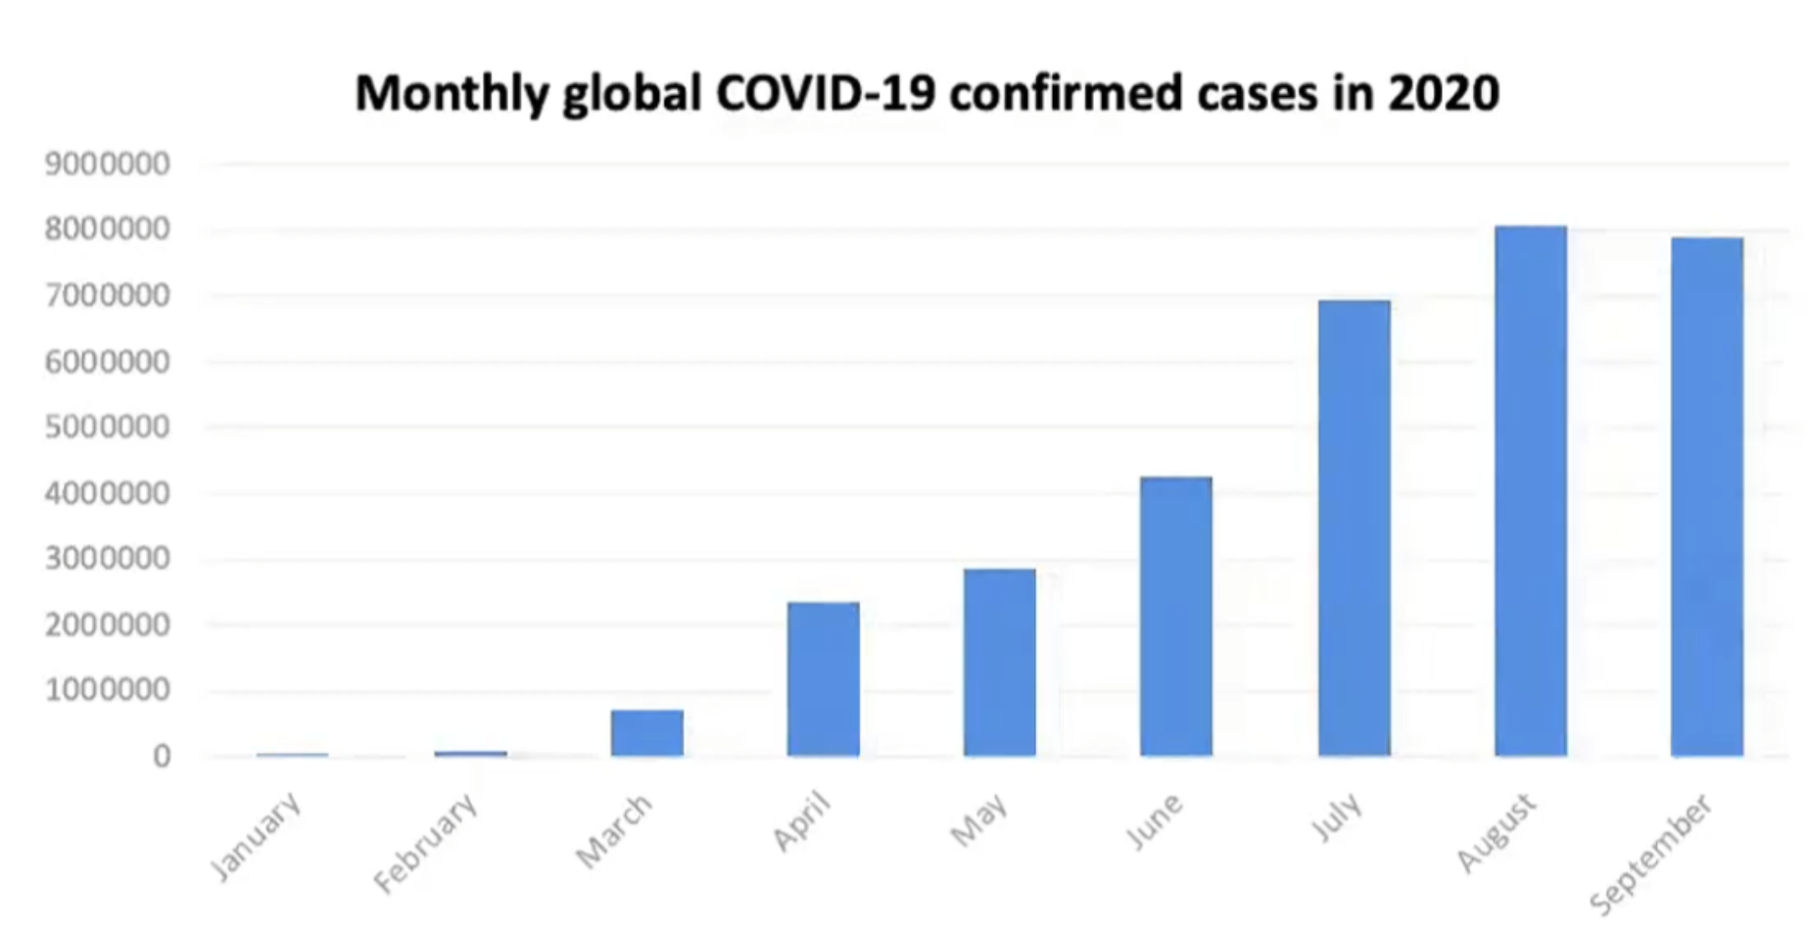
Critique This Viz

Slide 26
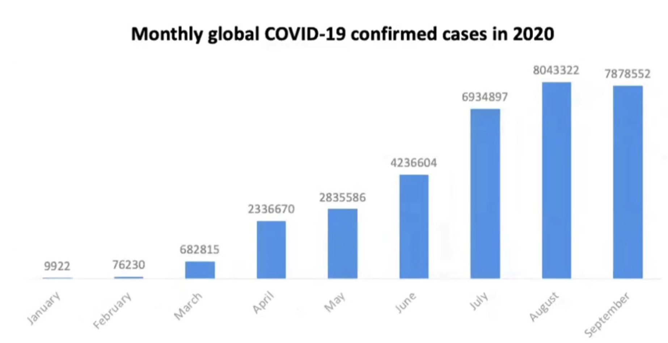
Critique This Viz

Slide 27
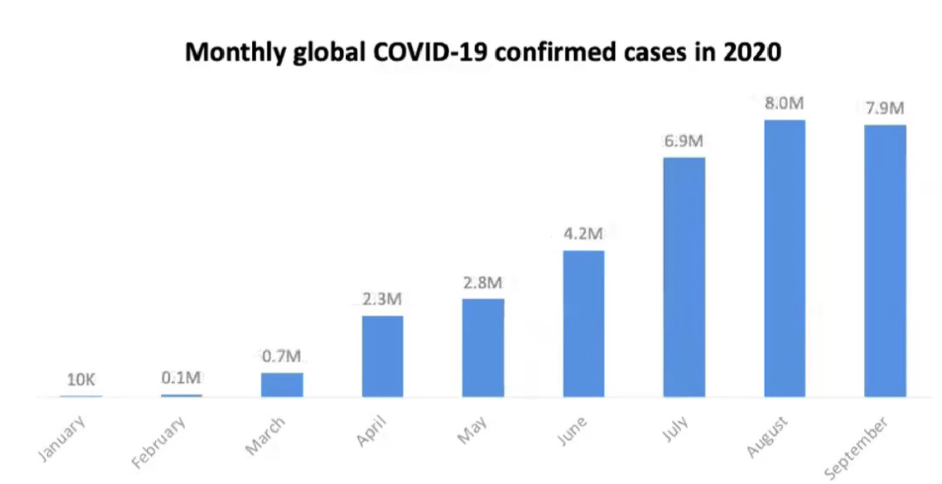
Critique This Viz

Slide 28
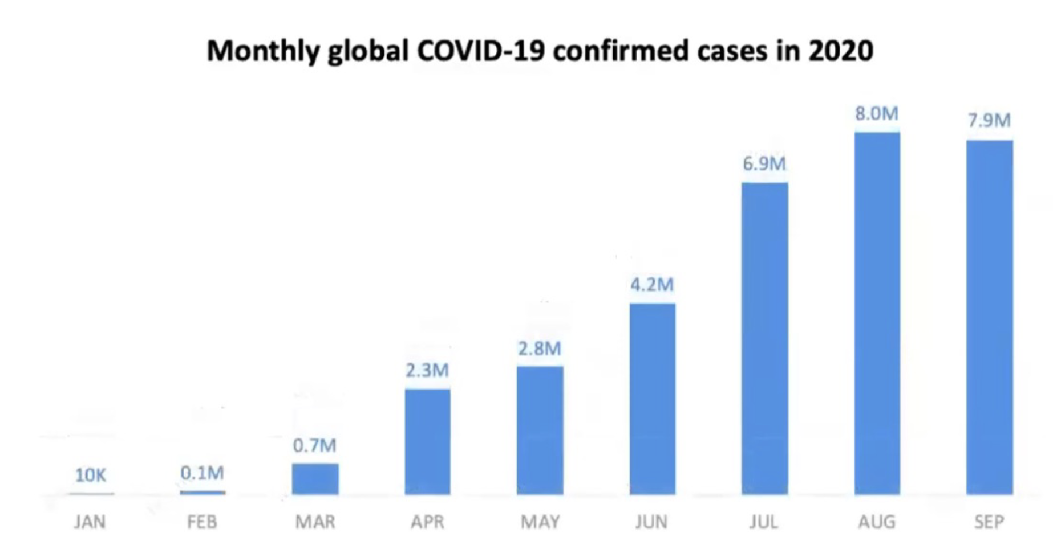
Critique This Viz

Slide 29
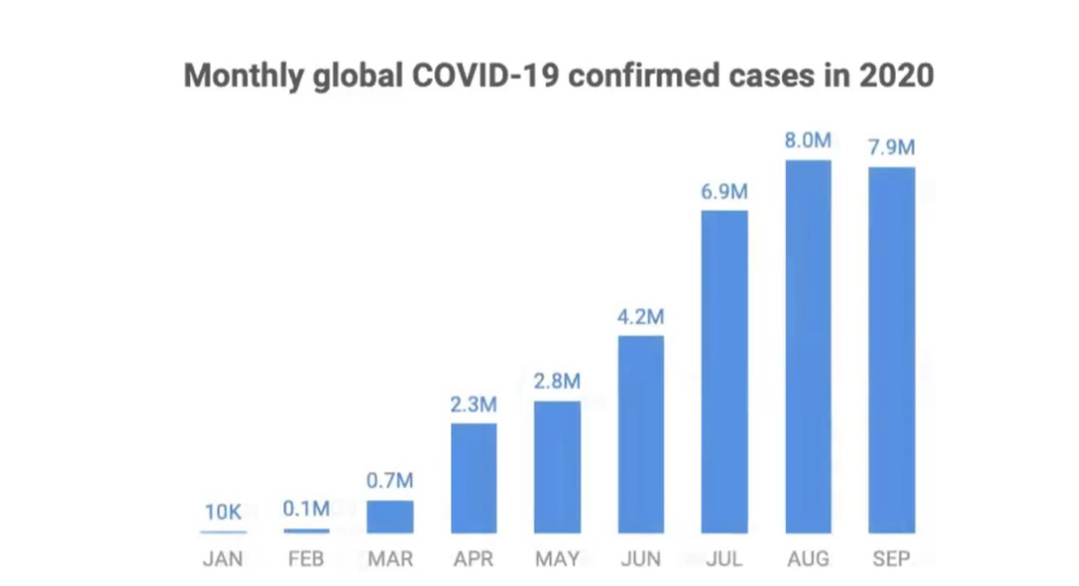
Critique This Viz

Slide 30
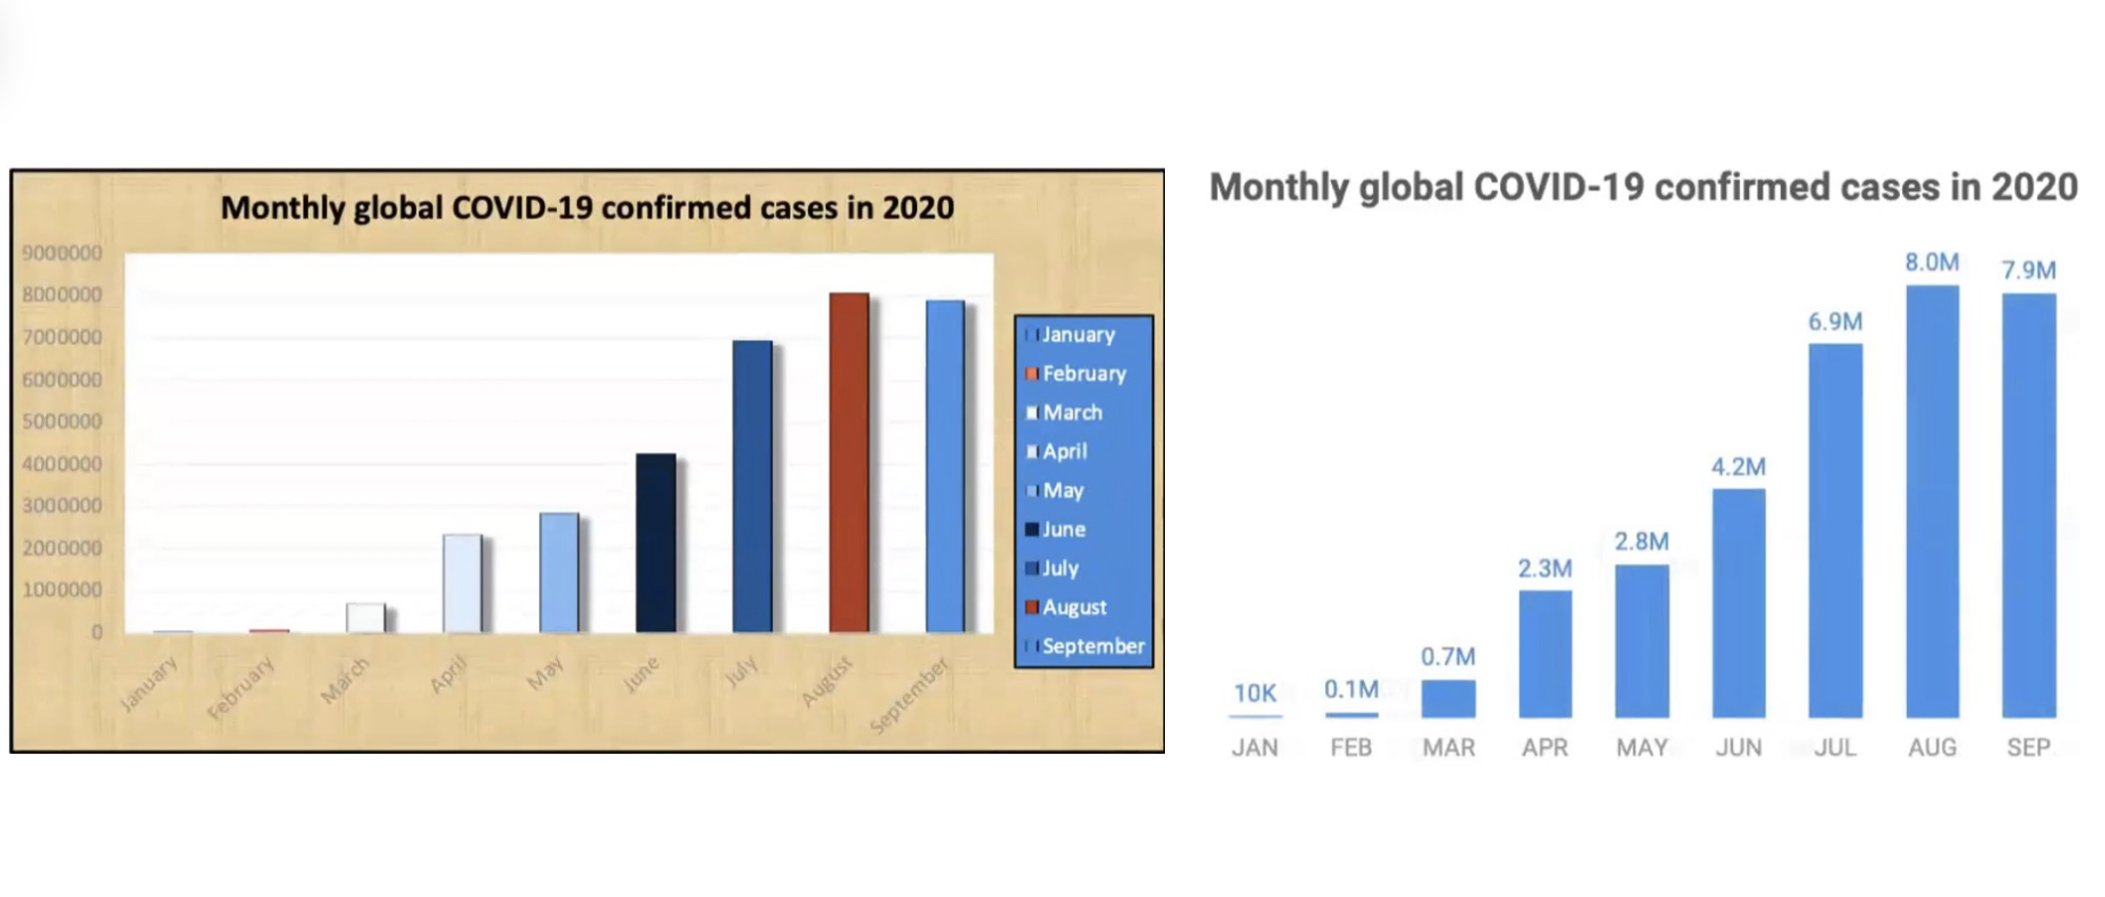
Critique This Viz

